Slide 1
Data Analysis Life Expectancy
Week 2: Linear regression excercise
Ronald Fokkink
14-02-2022

Slide 2
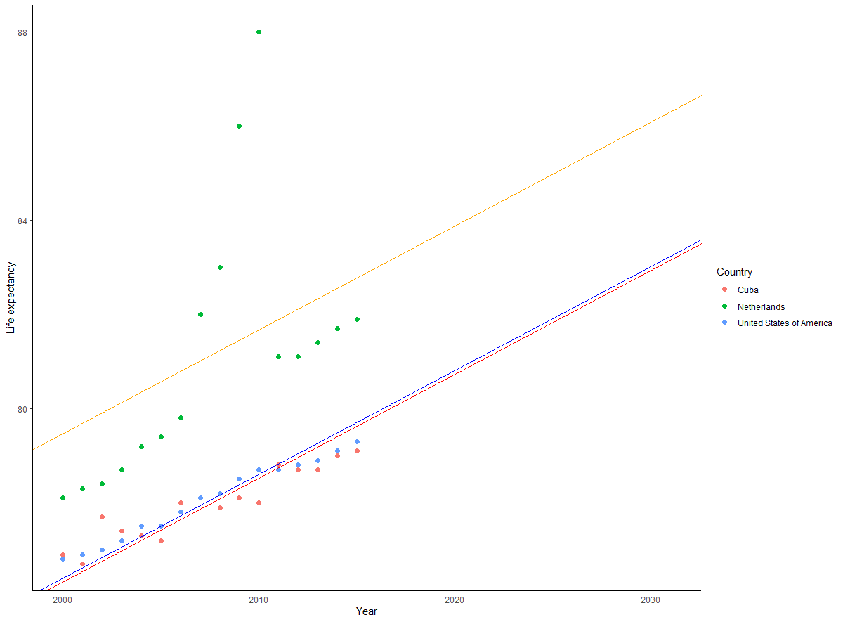
Simple model

Slide 3
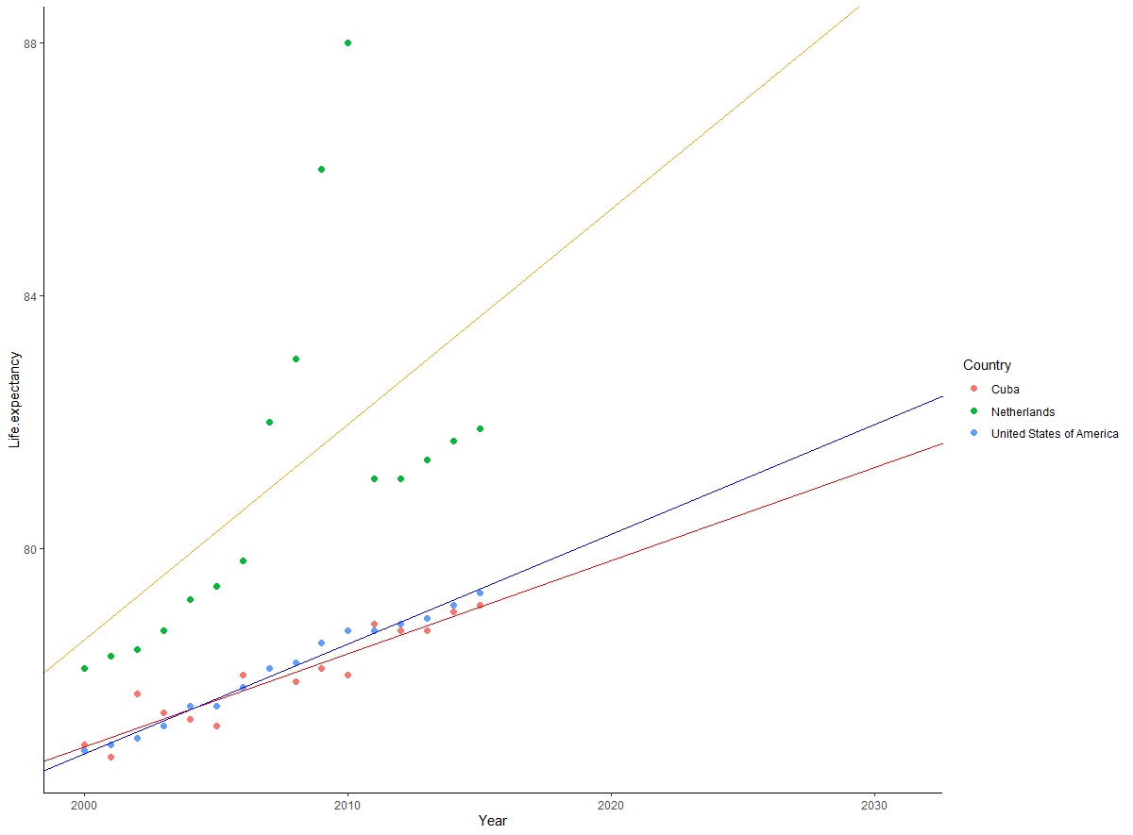
Improved model

